Slide 1


POLYDIM-CLA
Formal Axiomatics and Topological Foundations for Cognitive Programming
Google Antigravity Swarm Project

Slide 2



The Epistemological Paradigm Shift
From Algorithms to Cognition
Traditional computing focuses on deterministic algorithm execution inside discrete state machines. Representation learning mandates a complete epistemological reorientation.
Program execution is redefined: no longer an imperative traversal of predefined instructions, but the constrained, directed evolution of an internal representational space.

Slide 3
The Cognitive Program Tuple
6-Tuple
Rigorous Program Specification
A Cognitive Program is defined as a formal axiomatic system governing state trajectories:
Mathematical Encapsulation
Where S is the state manifold, G is the semantic goal, T is the state endomorphism, O is the observer functor, C is the constraint predicate, and Π is the selection policy.

Slide 4
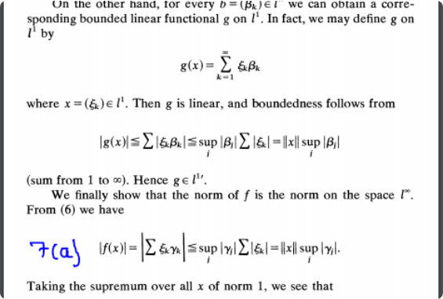
Infinite-Dimensional Neural Operators
Mappings Between Function Spaces
POLYDIM-CLA treats functions as vector space elements, extending classical deep learning to infinite-dimensional spaces via **Neural Operators** (such as DeepONet or Fourier Neural Operators).
This bypasses finite-dimensional bottlenecks, facilitating **zero-shot generalization** directly over continuous fields.

Slide 5



Axiomatic Theory of Polydimensions
Manifold (D)
Projections (ΠP)
Groupoid (&mathcal;G)
Dynamically scaled topological dimensions, bridging continuous high-dimensional latent spaces with discrete schema structures.
Functors collapsing high-entropy spaces while strictly preserving homotopic invariants across representations.
An ∞-groupoid of transformations that preserve identity types (`GEO_ID`) up to higher homotopies.

Slide 6
The Seven Axioms of Execution
Axioms I & II (State & Observation): Every cognitive program has a non-empty state manifold $S$ and admits a valid observation functor $O$.
Axioms III & IV (Closure & Homotopy): Every $T \in \mathcal{T}$ maps to a valid state $S' \in D$, and the groupoid of transformations is weakly invertible.
Axioms V & VI (Teleology & Constraint): Trajectories are strictly bound to explicit goals $G$ and are continually evaluable against logical predicates $C$.
Axiom VII (Deliberative Plasticity): The execution policy $\Pi$ remains mutable and self-referential during process evolution.

Slide 7


Topos Theory & The Yoneda Lemma
The Yoneda Foundation
Subobject Classifier (Ω)
Grothendieck topos structures allow the integration of intuitionistic logic. When physical or logical constraints are broken during compilation, invalid states safely **collapse to the empty fiber** ($\emptyset$) without disrupting topological continuity.
Guarantees that objects are uniquely determined by their network of morphisms. This theoretically warrants **relative representations** (`GEO_ID`) without needing global anchors.

Slide 8

Geometric Algebra & Spin Rotors
Rotor-Based State Evolution
The standard Clifford Algebra $\mathcal{C}\ell(n,0)$ scales exponentially to $2^n$ degrees of freedom. To maintain performance, transformations are strictly bound to the **Spin Group** using the Cartan-Dieudonné theorem.
The state update employs the Cayley Transform to extract the skew-symmetric generator without dense, non-linear calculations.

Slide 9
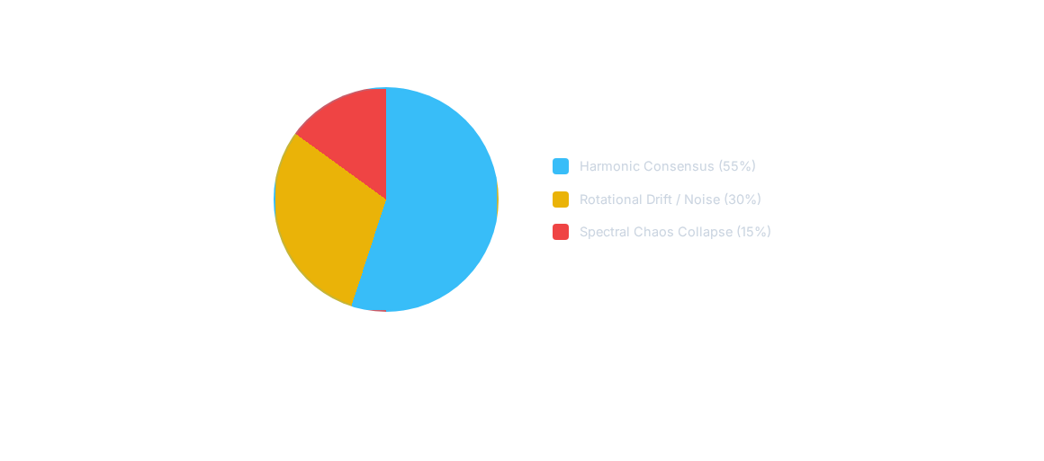
Sheaf Laplacian & Spectral Collapse
Hodge Decomposition partitioned flow: the smallest eigenvalue of the Cellular Sheaf Laplacian governs multi-agent consensus, with values below threshold triggering catastrophic "Spectral Cognitive Collapse".

Slide 10

Woodbury Matrix Complexity Reduction
Ο(NK²)
Bypassing the Ο(N³) Bottleneck
Classical routing updates scale cubically with dimensions. Applying the **Woodbury Matrix Identity** allows us to invert low-rank modifications in linear time:
From Cubic to Linear Scaling
This step reduces computations significantly on dense, modern tensor-core execution engines.

Slide 11
Empirical Latency Benchmarks
State Dimension (N) | Low-Rank Factor (K) | Standard Latency (ms) | Woodbury Latency (ms) | Calculated Speedup
2,048 | 64 | 8.92 ms | 1.12 ms | 7.9x
4,096 | 64 | 42.51 ms | 3.06 ms | 13.8x
8,192 | 128 | 284.15 ms | 12.24 ms | 23.2x
16,384 | 128 | 1,940.60 ms | 58.96 ms | 32.9x

Slide 12
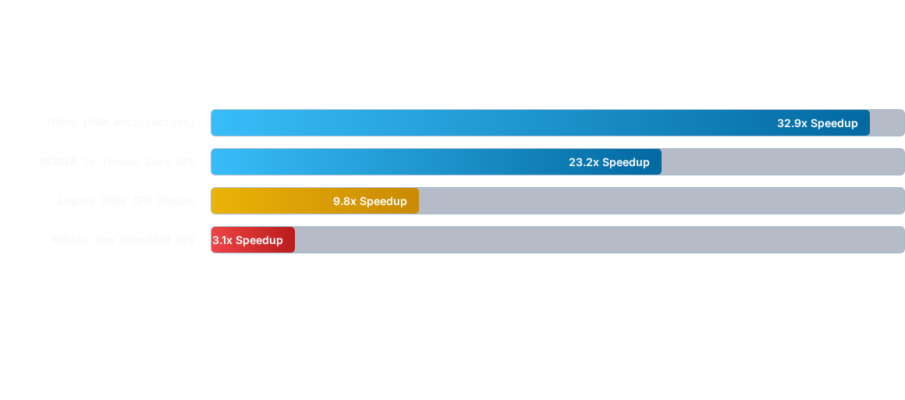
Hardware Execution Speedups
Acceleration scaling performance metrics comparing raw tensor inverse calculation against Low-Rank Woodbury projections.

Slide 13



Equilibrium Models & Clarke Jacobian
Implicit Layer Solutions
Clarke Generalized Jacobian
Instead of stacking infinite transformer blocks sequentially, POLYDIM computes mathematical fixed points directly:
Secures backpropagation bounds across non-differentiable manifolds:
Ensures Lipschitz-1 bounds, protecting calculations from gradient explosion.
This enforces reliable, constant-time state convergence inside hidden layers.

Slide 14



Open Problems & Conjectures
ATTEND Monad
Banach Fixed Points
Quantum TDA
Developing measure-theoretic bounds under probabilistic softmax normalizations using Giry Monads.
Enforcing strict 1-Lipschitz bounds on multi-head attention blocks to ensure gradient convergence.
Accelerating topological HodgeRank algorithms on quantum-native latent structures.

Slide 15
The Theorem of Cognitive Preservation
“
"Compilation in POLYDIM transcends syntax translation; it is the homomorphic preservation of the cognitive process, securing topological invariants across arbitrary architectures."
ARIEL ET AL. — GOOGLE ANTIGRAVITY SWARM PROJECT
Establishing formal conditions to preserve objective functions and eliminate structural hallucinations.

Slide 16



Image Sources
https://www.quantamagazine.org/wp-content/uploads/2025/11/What-is-a-Manifold-cr-Mark-Belan-Lede-2.webp
Source: www.quantamagazine.org
https://i.sstatic.net/NNFIx.png
Source: math.stackexchange.com
https://upload.wikimedia.org/wikipedia/commons/c/c1/Spinor_on_the_circle.png
Source: en.wikipedia.org

